Slide 1
PRISM
Daniel Hellfeld

Slide 2
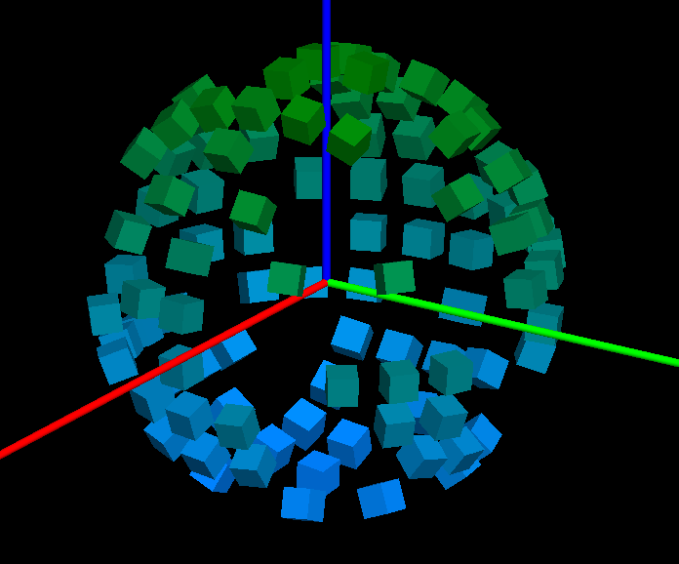
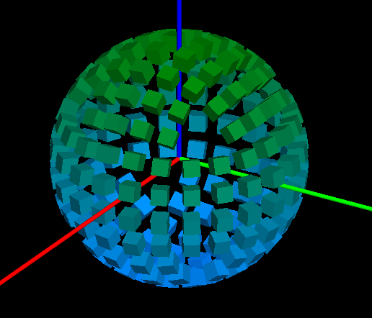
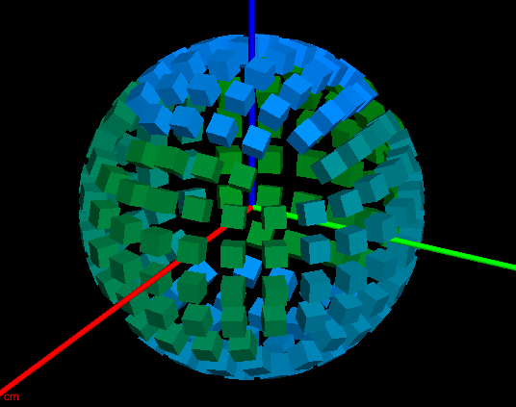
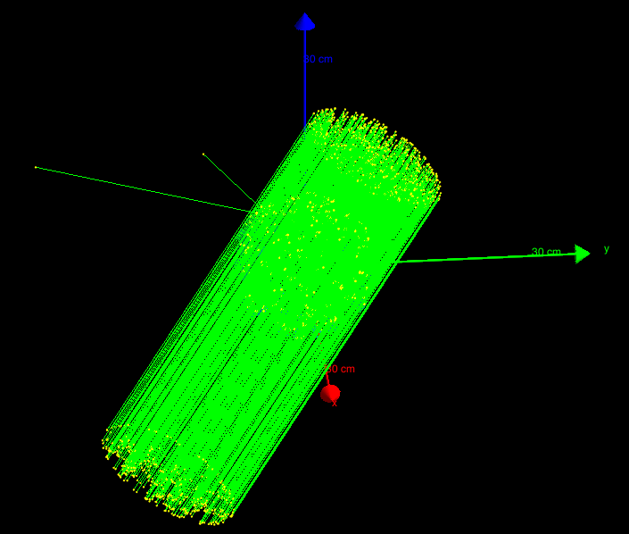
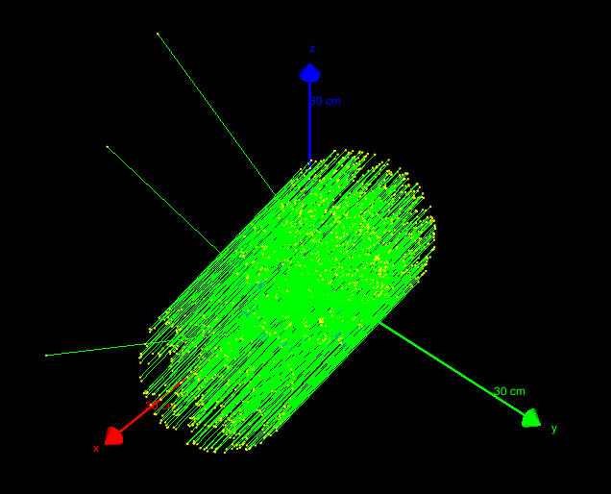
Geant4 simulation – PRISM_SIM
(https://github.com/dhellfeld/CAI_Toy_Imager)
Random mask – ringed detectors
Fully populated – ringed detectors
Fully populated – nested detectors
Running particles

Slide 3
# Run.mac
# Tracking secondary electrons
#/PRISM_SIM/tracking/trackElectrons Off
# Detector indexing
/PRISM_SIM/geom/detIndexing Ring
# Configure mask
#/PRISM_SIM/geom/setMask 21524FA478BD521AB44791322B545C979943A029753854BB
#/PRISM_SIM/geom/randomMask
/PRISM_SIM/geom/fullMask
# Change the energy
/gun/energy 60 keV
# Set the direction of far field source
#/PRISM_SIM/direction/setTheta 45
#/PRISM_SIM/direction/setPhi 20
# Configure HEALPix
/PRISM_SIM/direction/setHPNside 8
/PRISM_SIM/direction/setHPindexscheme Ring
/PRISM_SIM/direction/SetUpHEALPix
# Choose a HealPix angle (start at 1)
/PRISM_SIM/direction/setHPindex 45
# Change output file name
/PRISM_SIM/output/filename output1
#Print to text or binary format
/PRISM_SIM/output/printText Off
/PRISM_SIM/output/printBinary On
# Beam on
/run/beamOn 100
# Response.mac
#/control/loop macros/response/healpix/main.mac hpindex 1 768 1.
/control/loop macros/response/healpix/main.mac hpindex 1 3072 1.
# Main.mac
# Pick healpix angle
/PRISM_SIM/direction/setHPindex {hpindex}

Slide 4
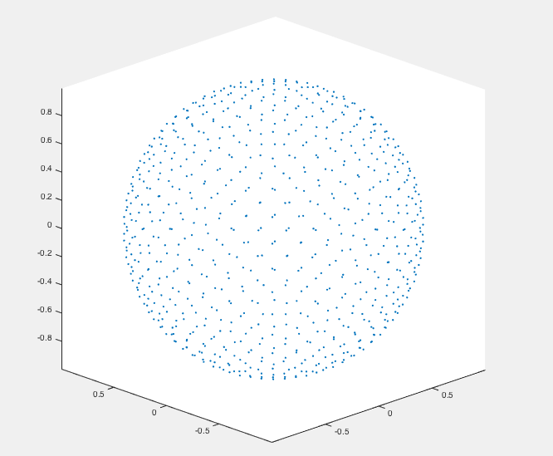
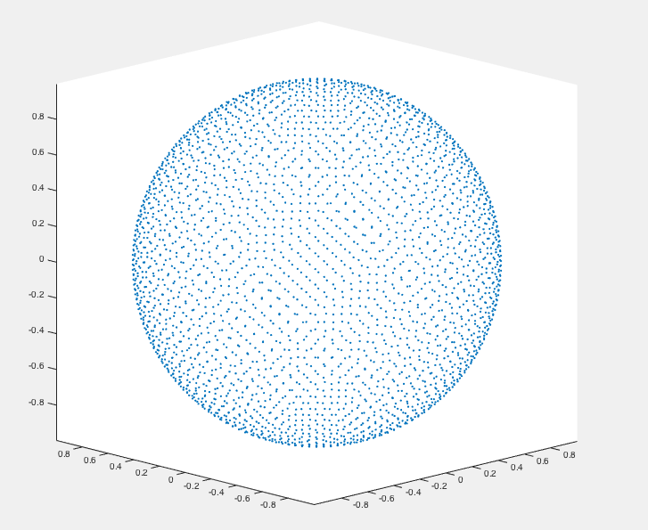
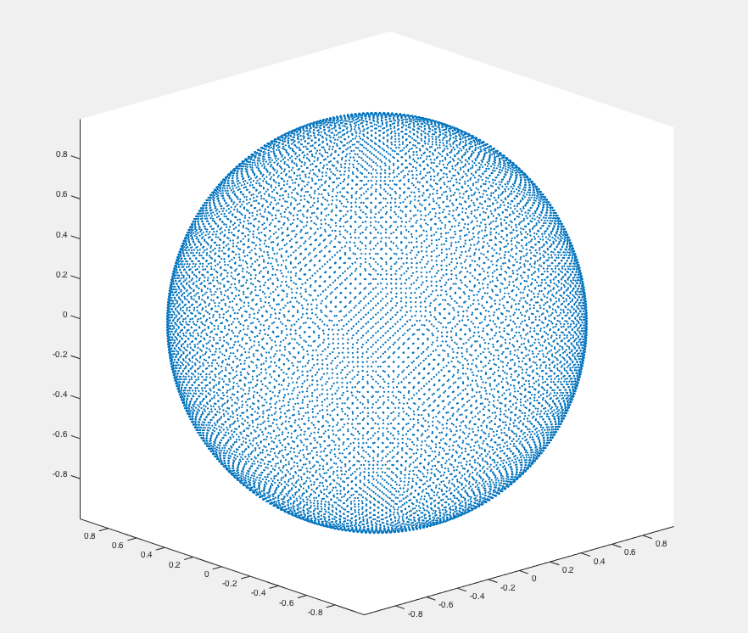
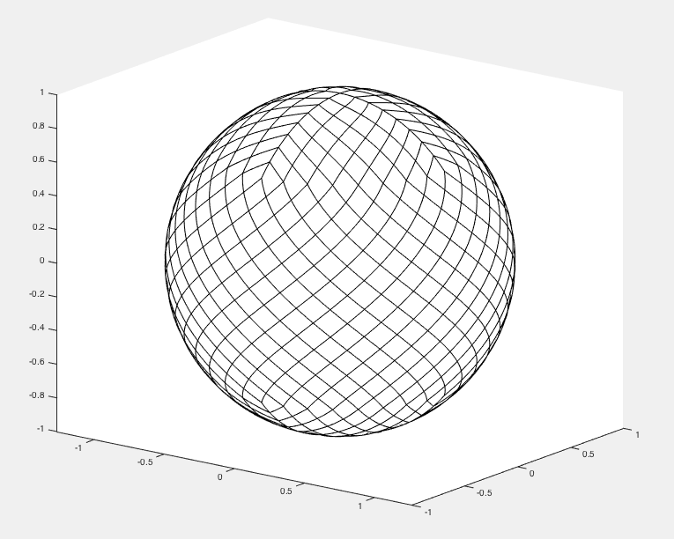
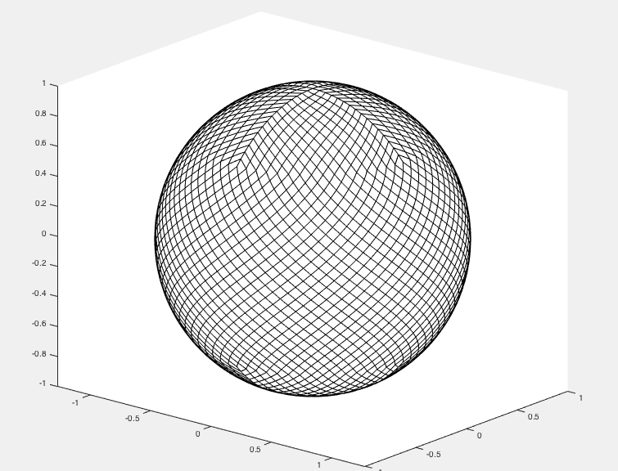
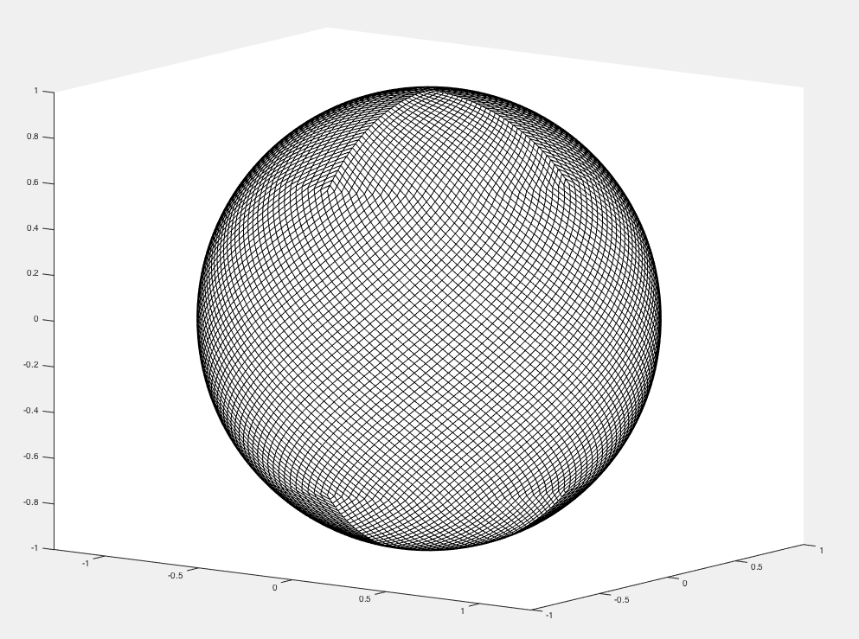
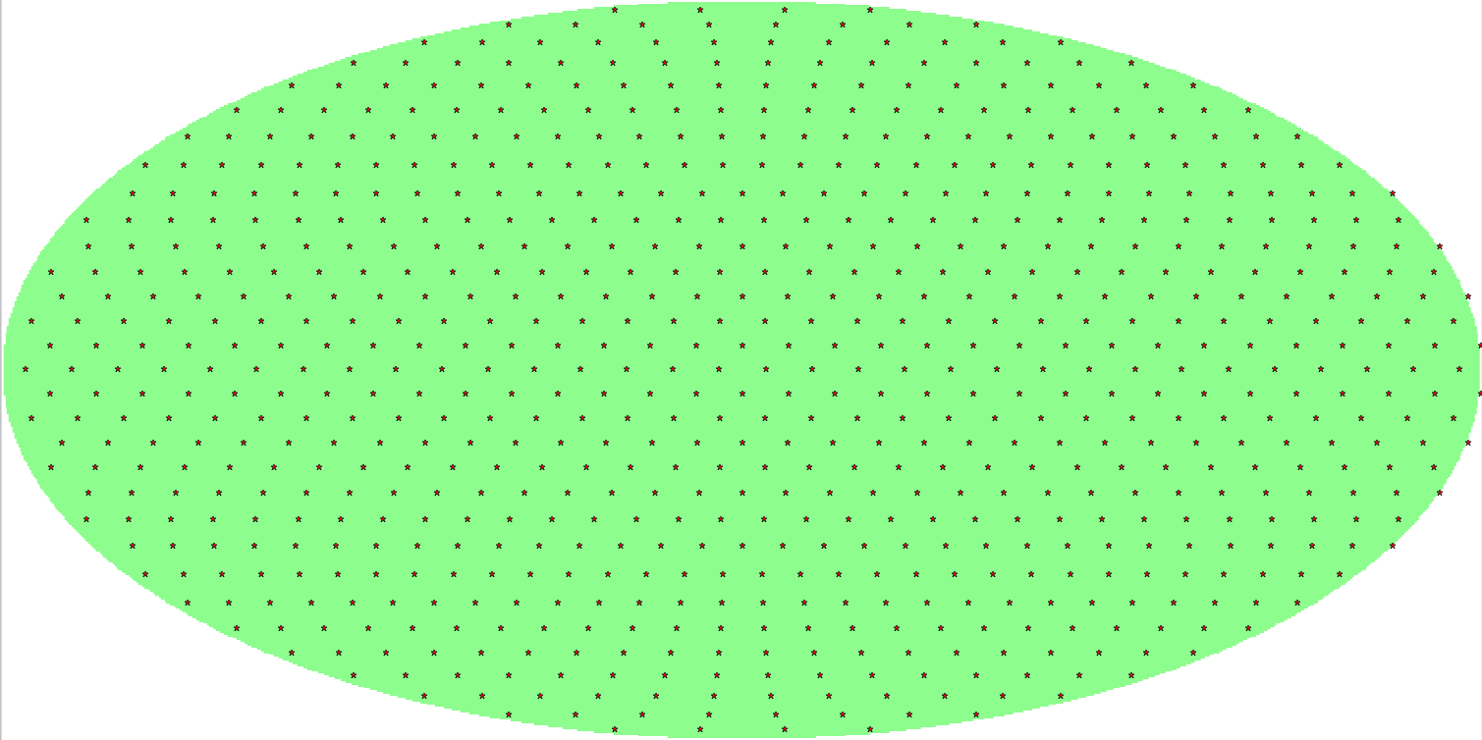
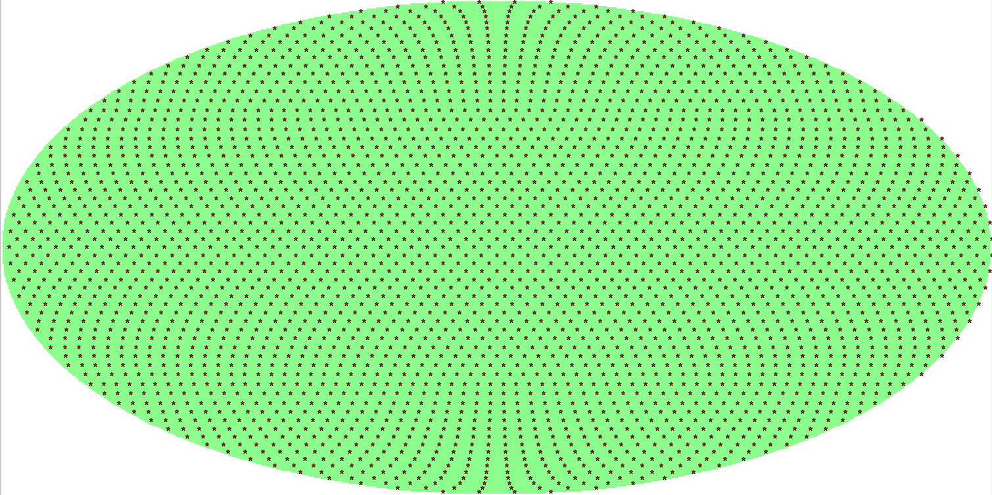
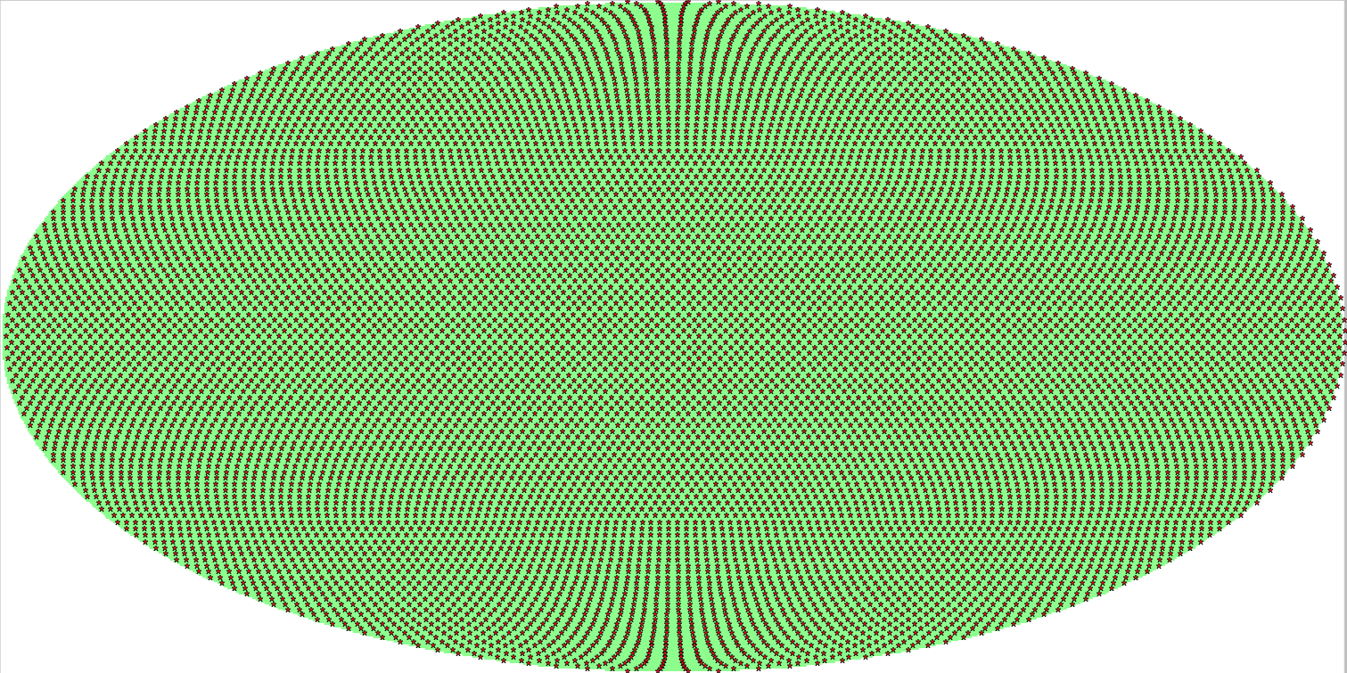
HEALPix – Hierarchical Equal Area isoLatitude Pixelization of a sphere
(Nested or ring … everything done in ring indexing)
Matlab (http://homepage2.nifty.com/plasma/program/healpix.html)
Nside = 8 (768 pixels)
Nside = 16 (3072 pixels)
Nside = 32 (12288 pixels)
Resolution = 7.3 deg
Resolution = 3.7 deg
Resolution = 1.8 deg
Python (healpy) (http://healpy.readthedocs.io/en/latest/index.html)
Nside = 8 (768 pixels)
Nside = 16 (3072 pixels)
Nside = 32 (12288 pixels)

Slide 5
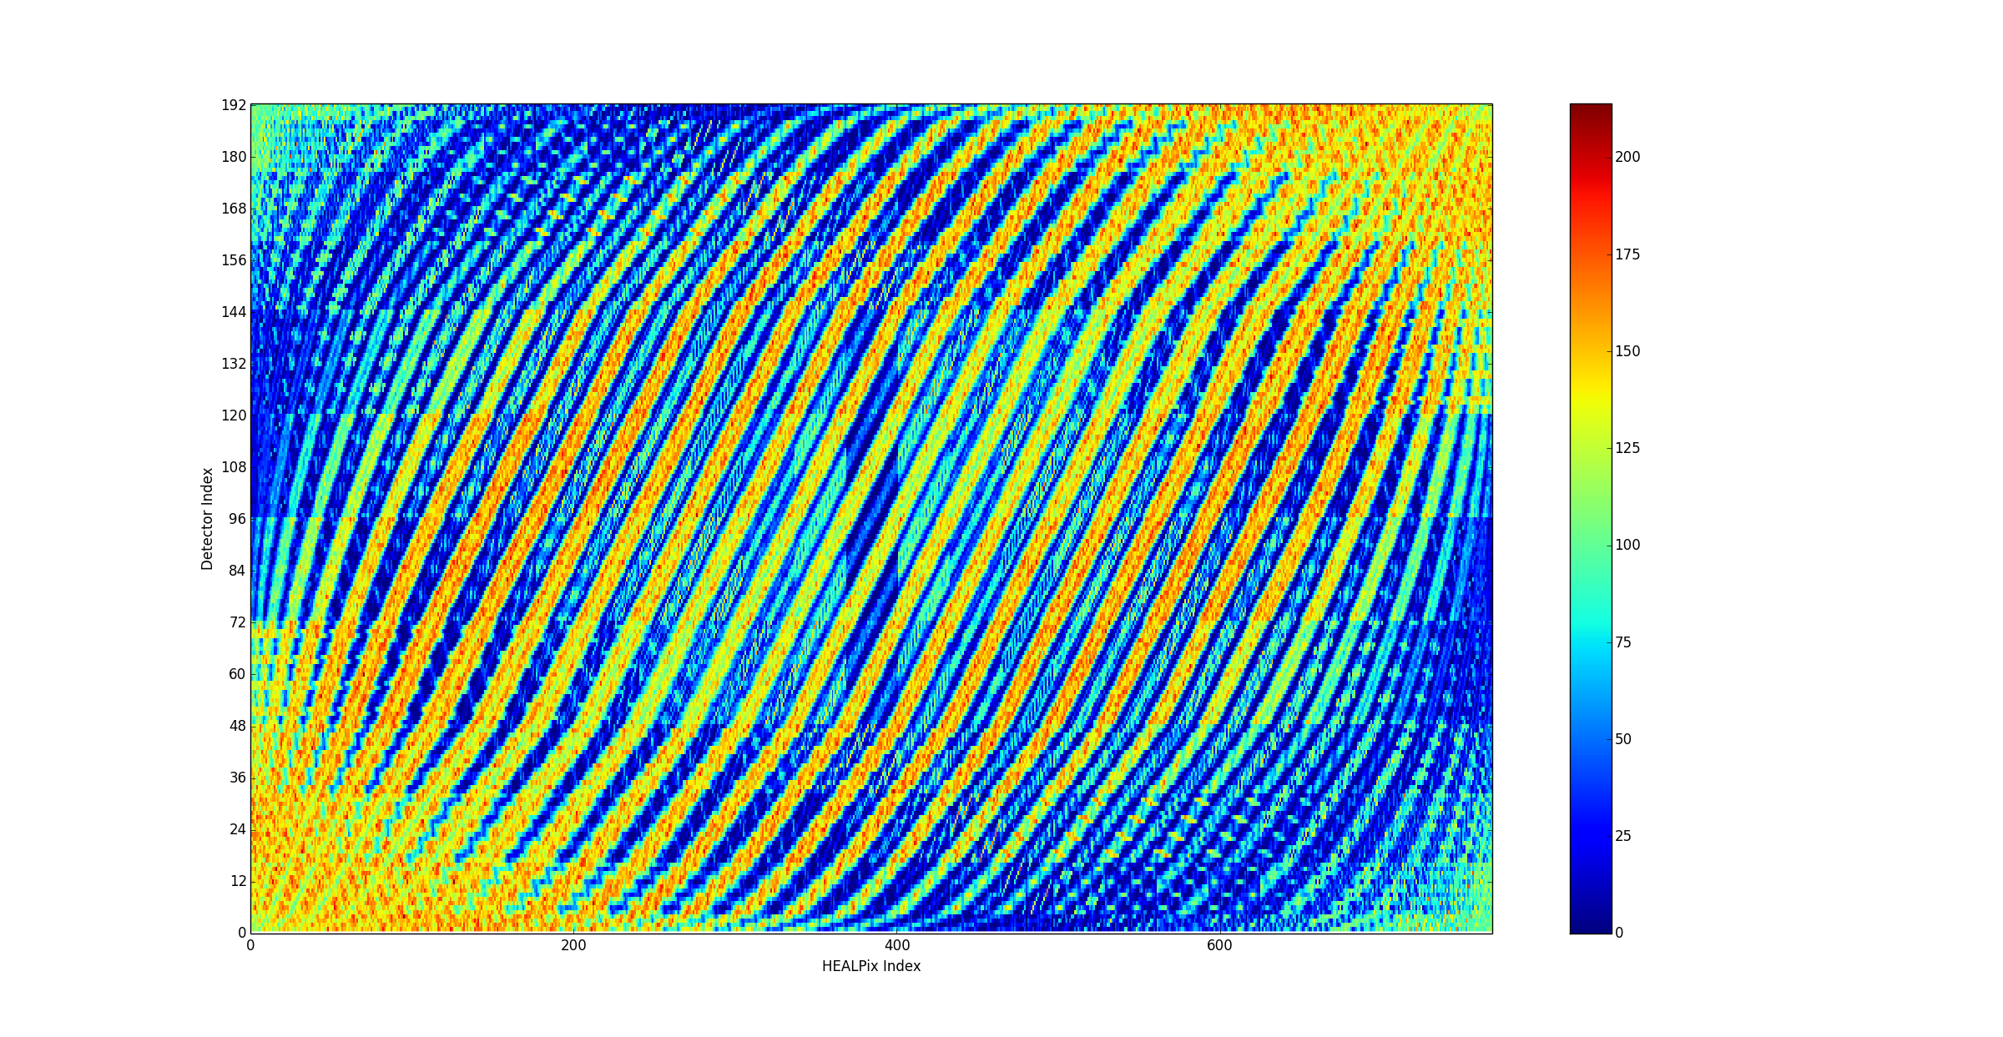
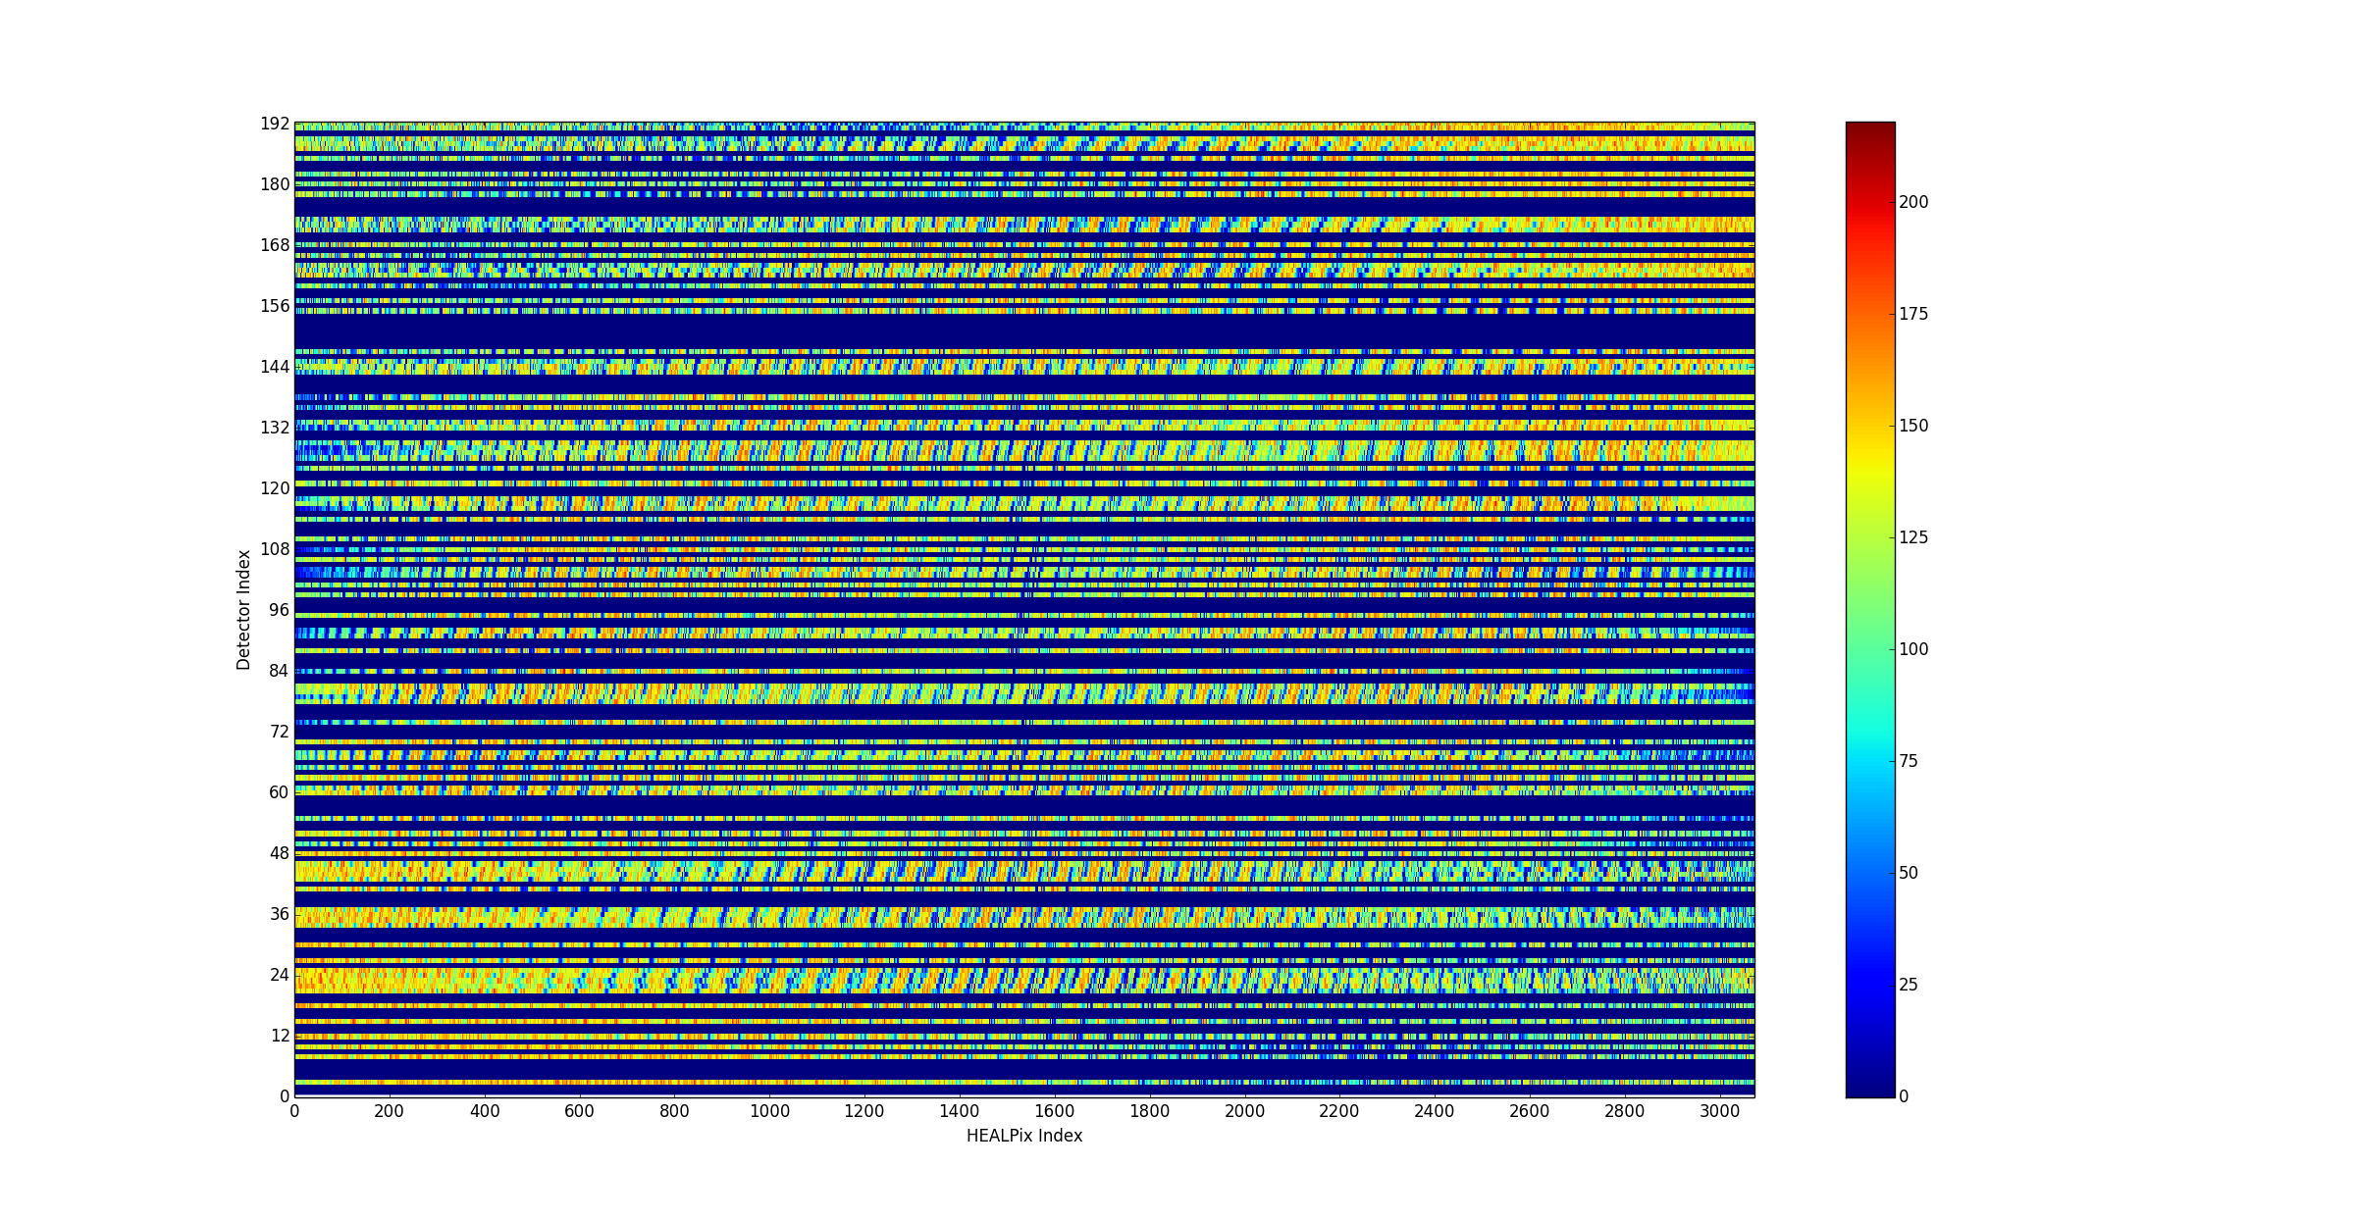
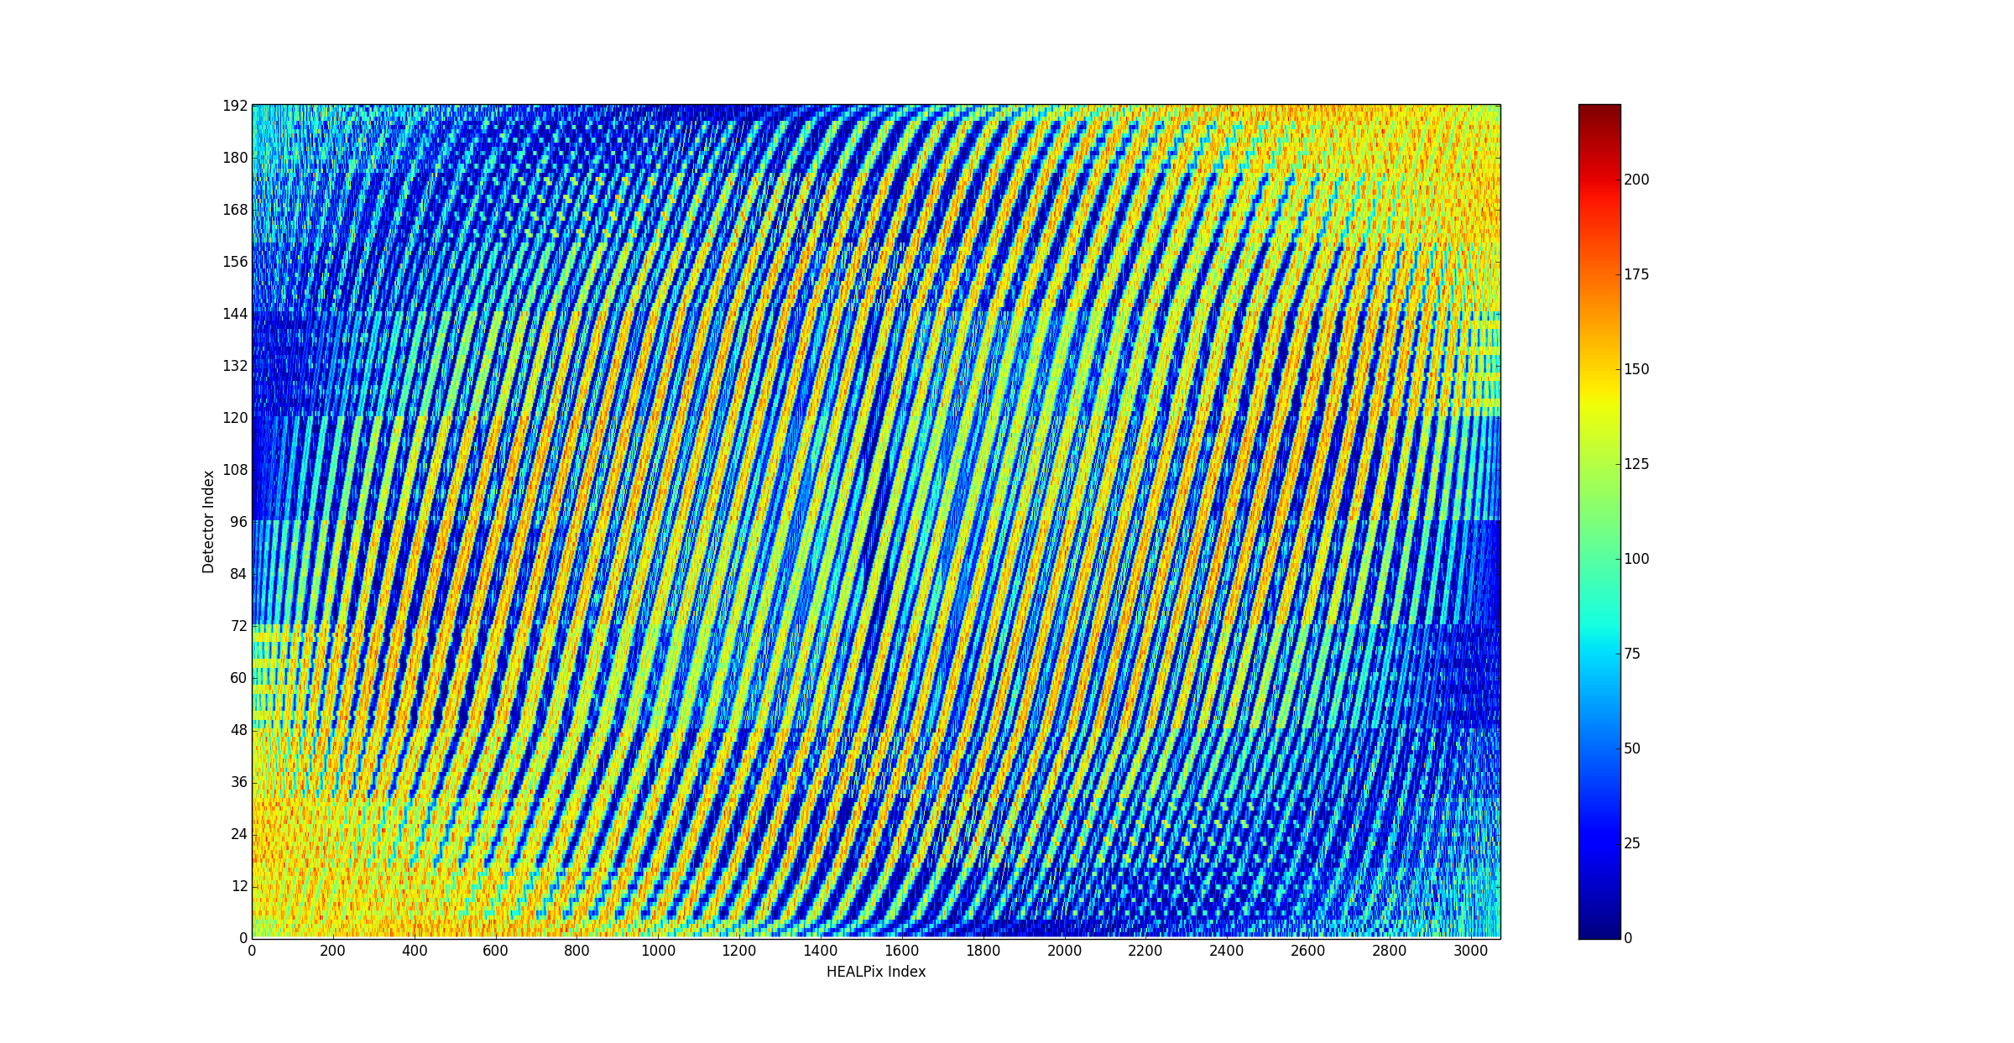
HP ringed, Nside = 8, Ringed detectors, 20k particles, mask = full
HP ringed, Nside = 16, Ringed detectors, 20k particles, mask = 2151…
HP ringed, Nside = 16, Ringed detectors, 20k particles, mask = full

Slide 6
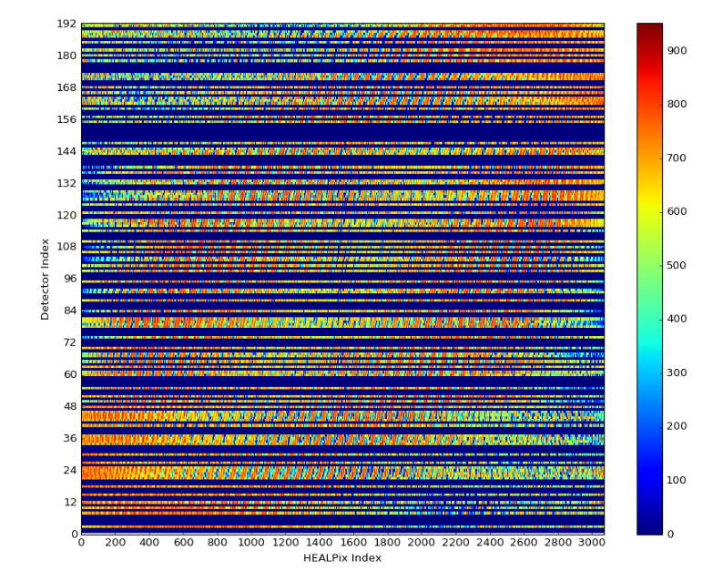
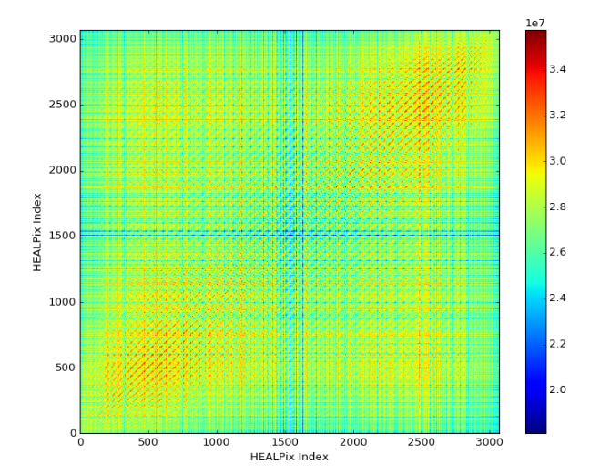
System response = S
S^{T}S (~autocorrelation)
Detector ID vs. Incident HP index
HP ringed, Nside = 16, Ringed detectors
100k particles, mask = 2152…

Slide 7
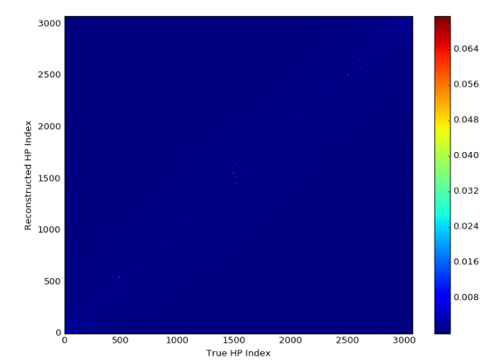
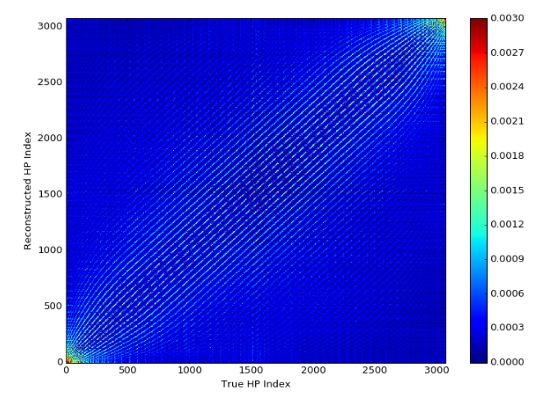
MLEM reconstruction at every source angle
Bring down color map

Slide 8
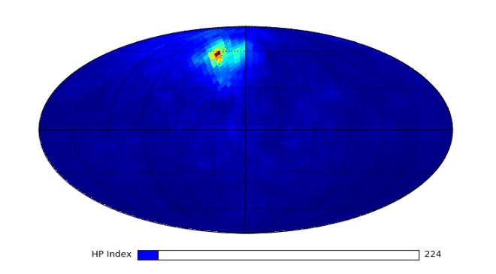
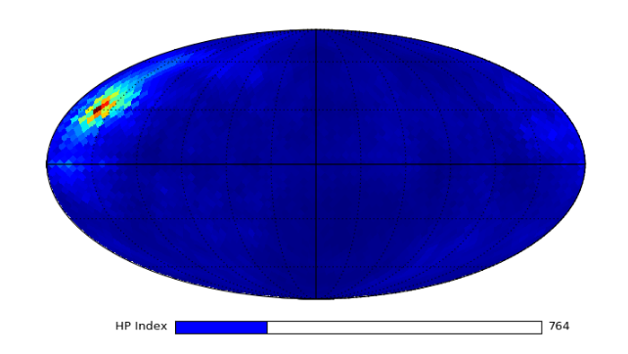
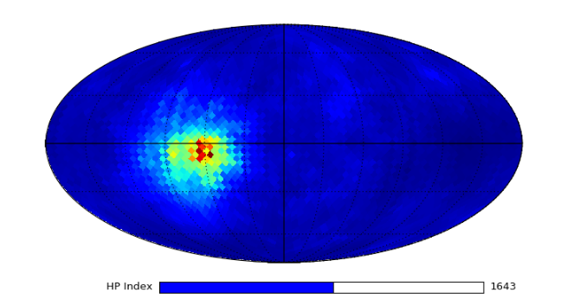
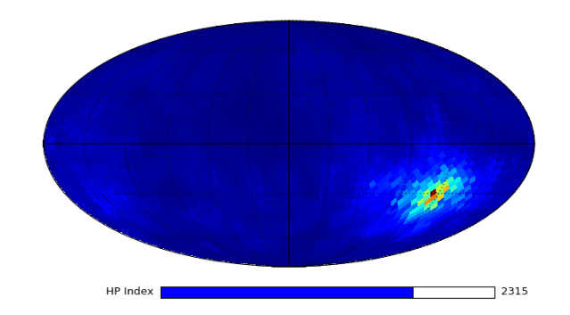
MLEM reconstruction on 4pi sphere with interactive slider
(25 iterations)

Slide 9
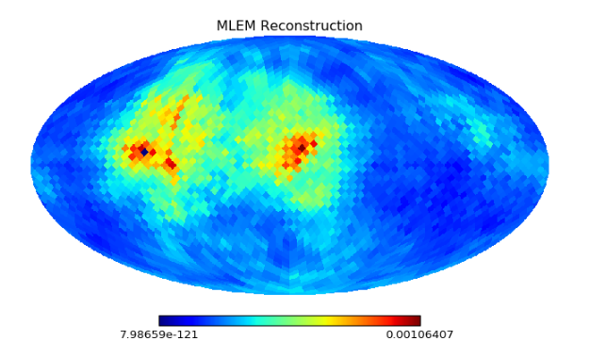
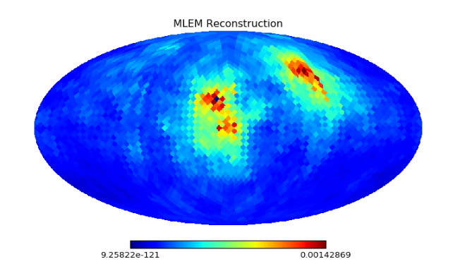
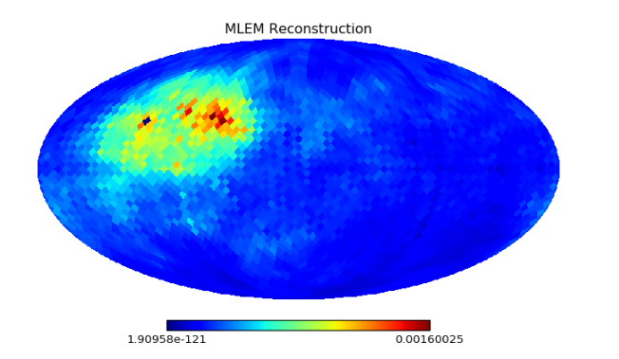
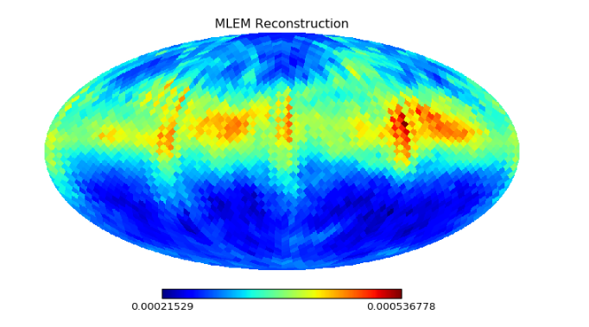
Two sources, ring source
(now put a white cross on true location…)
HP = 1330, 1310
HP = 930, 530
HP = 820, 810
HP = 1248:1312 (ring)

Slide 10
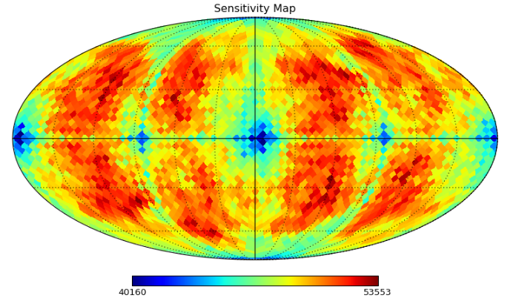
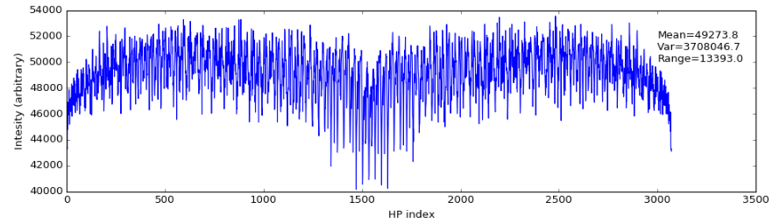
Notice range

Slide 11
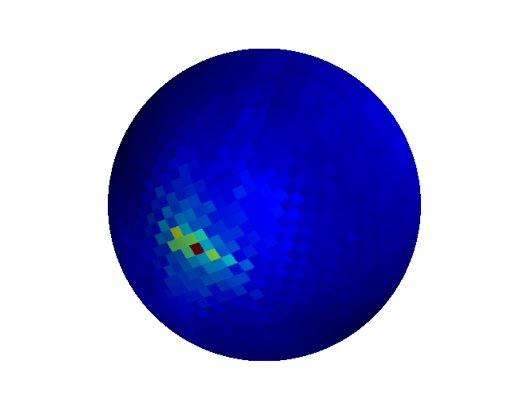
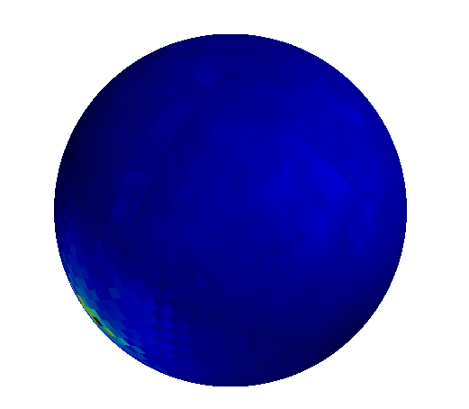
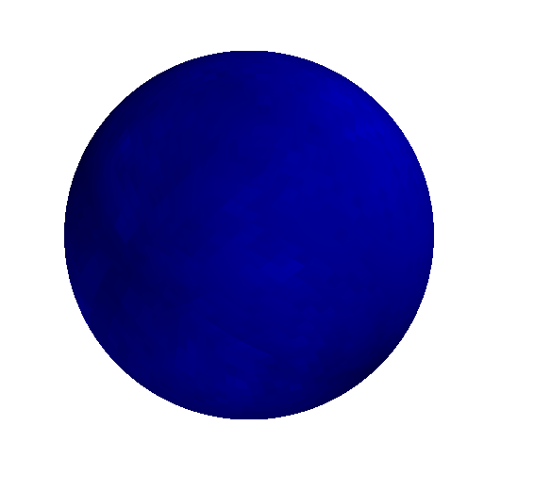
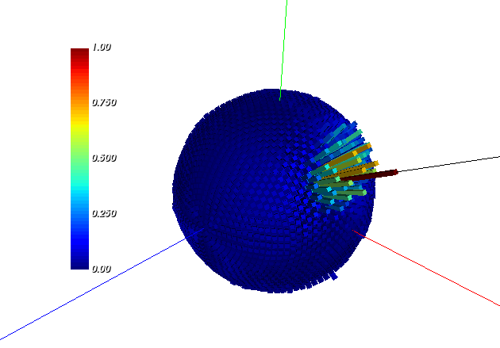
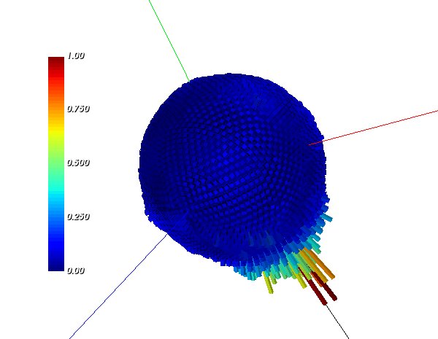
MLEM reconstructed image on 3D sphere (mayavi python)
(heat map)
Spherical histograms (VTK python)
- As opposed to heat map

Slide 12
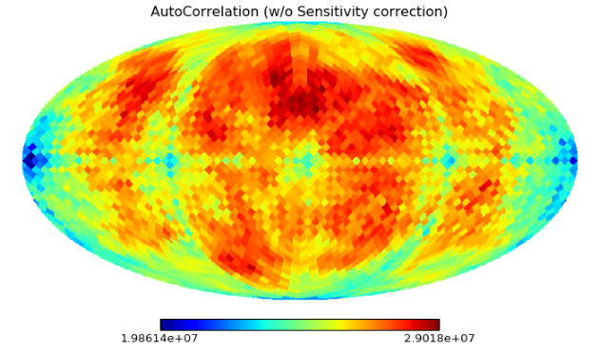
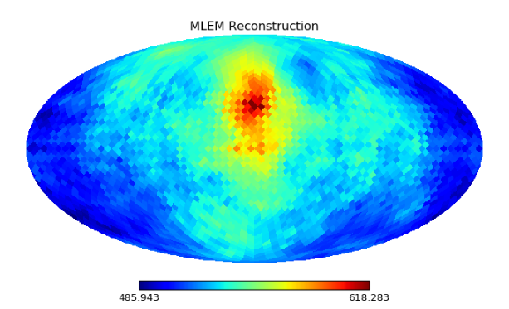
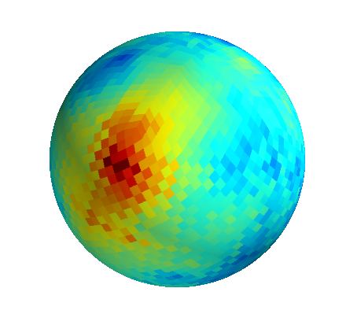
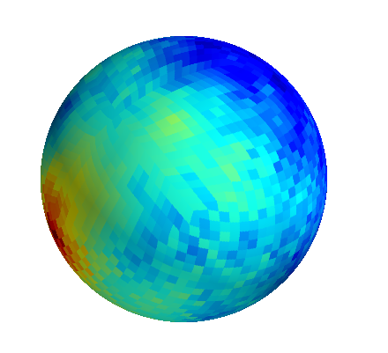
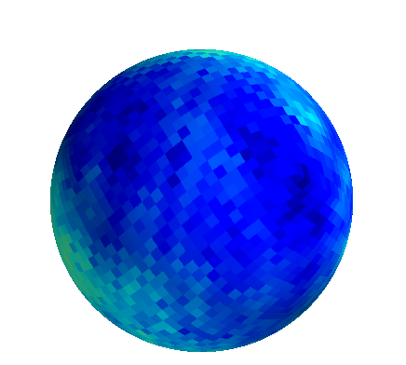
Autocorrelation image, not corrected for sensitivity map
HP index = 800
Row of autocorrelation, corrected for sensitivity map

Slide 13
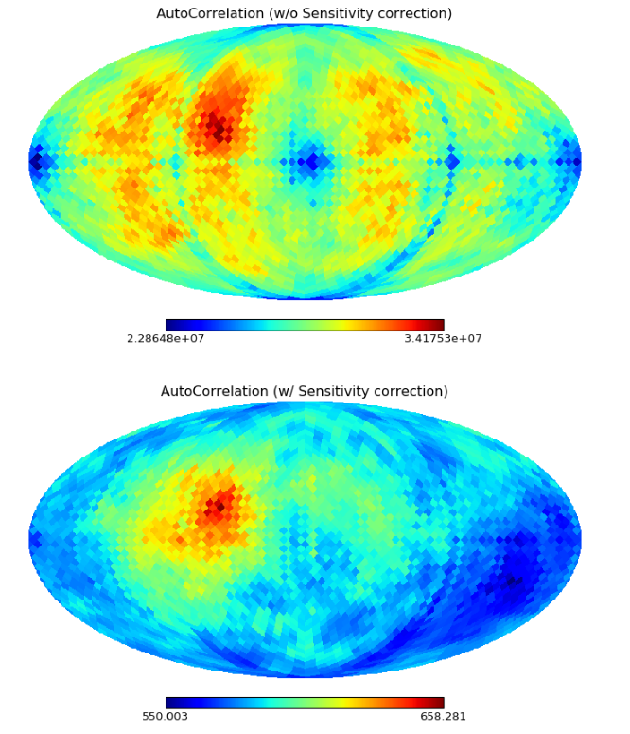
HP index = 1066

Slide 14
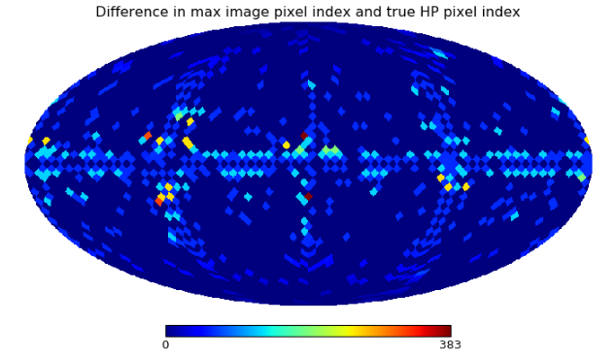
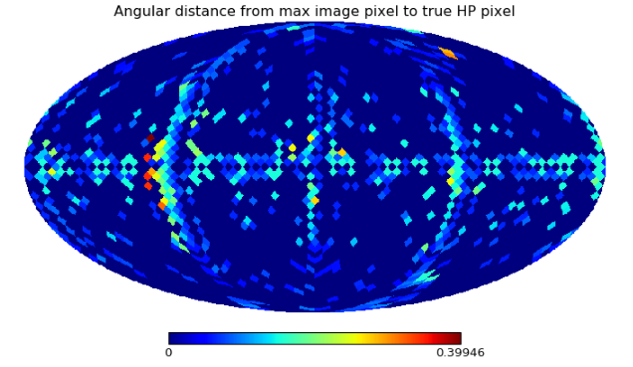
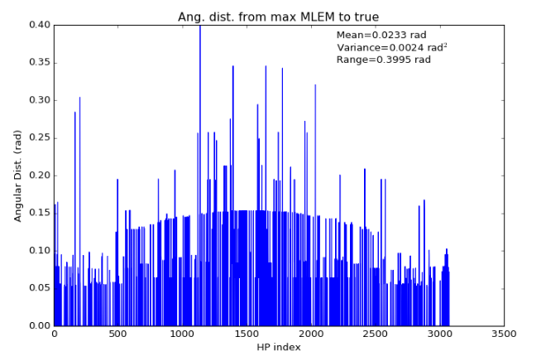
Distance between the peak image pixel index and the true source pixel index for all MLEM reconstructions (not good because it can blow up for images off by a ring)
Angular distance (rad) between the peak image pixel and the true source pixel for all MLEM reconstructions . Gives us a sense of accuracy.

Slide 15
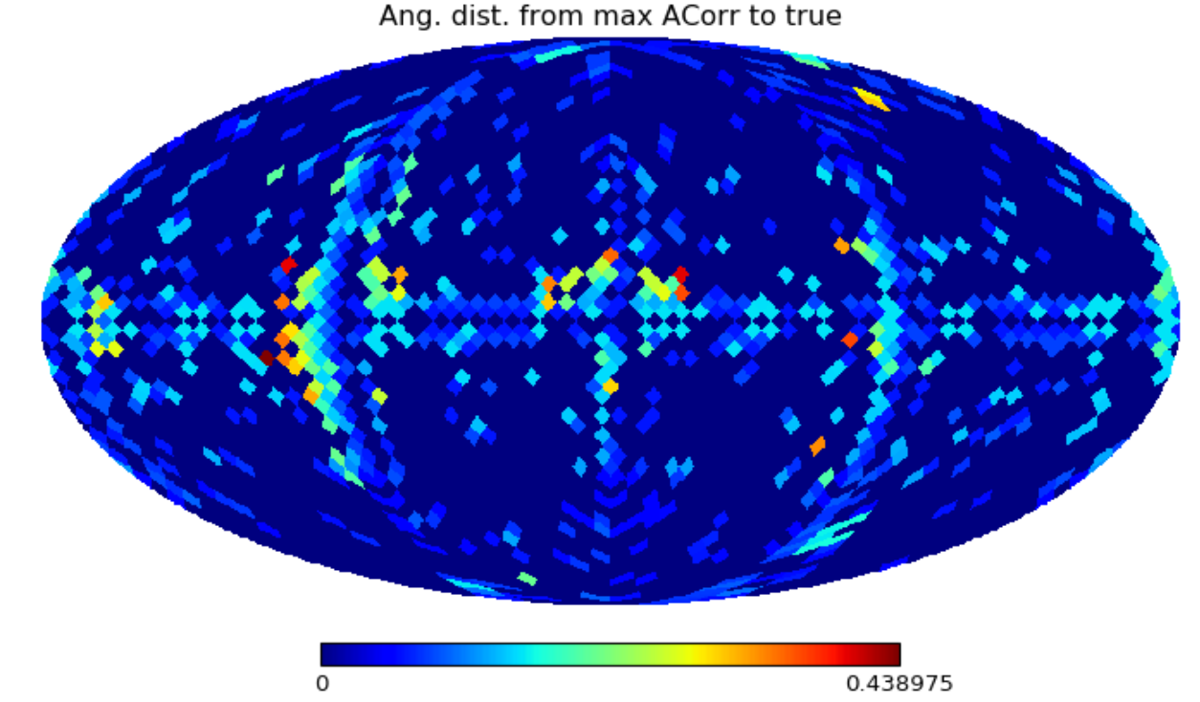
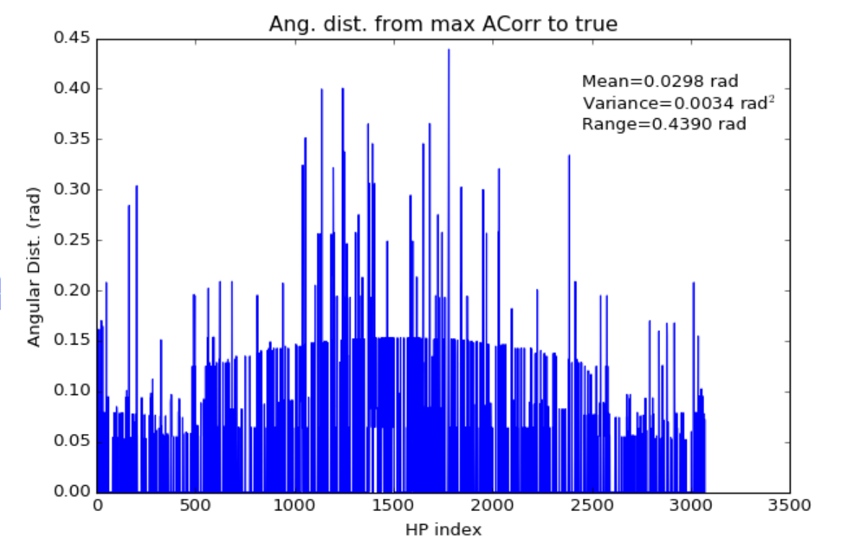
Using the autocorrelation instead of the MLEM image

Slide 16
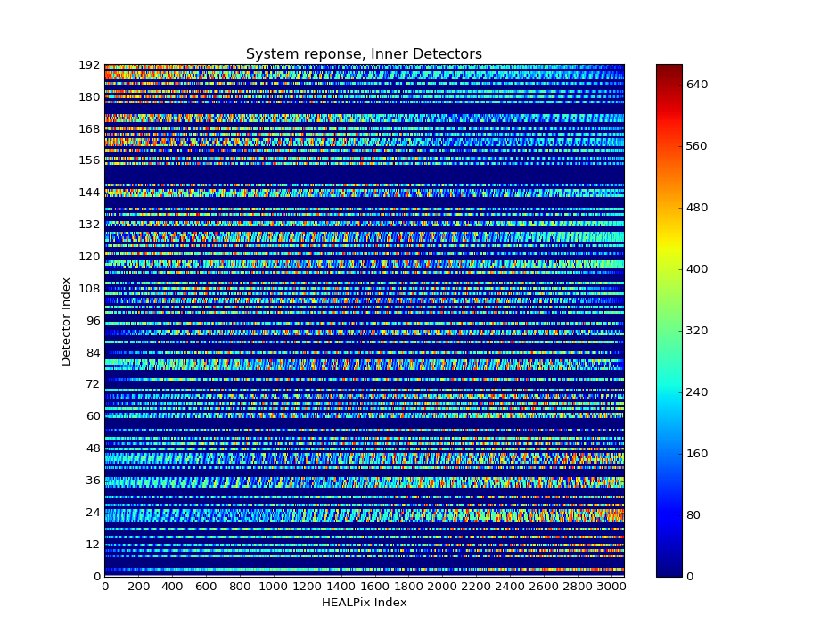
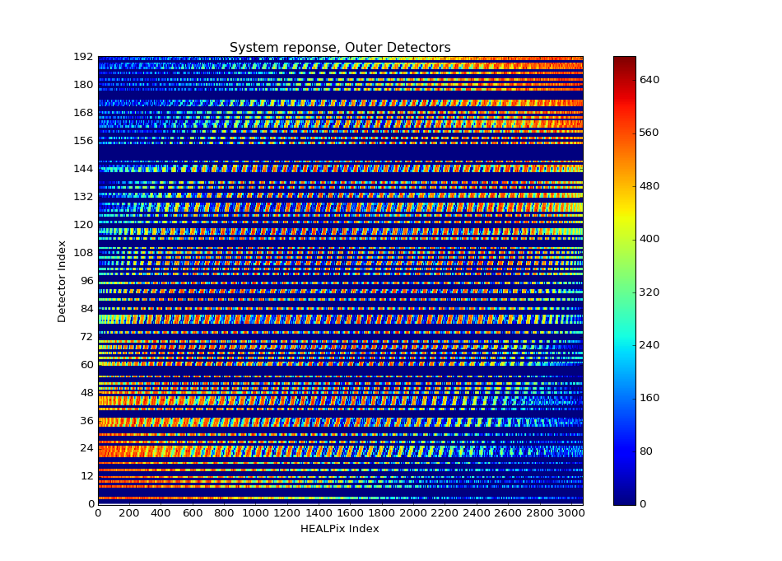
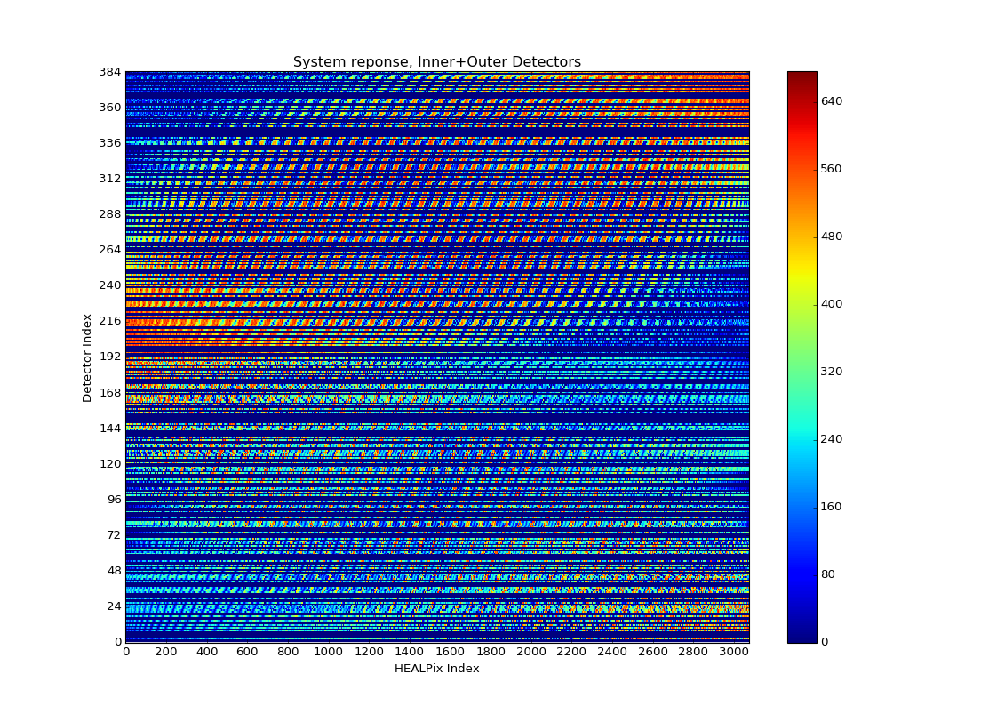



DOI (inner, outer, combined)

Slide 17



DOI – Inner, Outer, Combined

Slide 18



DOI – Inner, Outer, Combined
combined
outer
inner

Slide 19




OUTER
HP = 1568
HP - 2068

Slide 20




INNER
HP – 1568
HP = 2068

Slide 21




COMBINED
HP – 1568
HP = 2068

Slide 22



Sensitivity correct the autocorrelation (inner, outer, combined)
Outer
Inner
Combined

Slide 23








Single source
HP = 1070
HP = 2022
No doi
outer
inner
combined

Slide 24








Two sources (azimuthal)
No doi
outer
inner
combined

Slide 25








Two sources (polar)
No doi
outer
inner
combined

Slide 26


Max to true metric (outer)

Slide 27


Max to true metric (inner)

Slide 28




Max to true metric (combined)

Slide 29




Image variance – no DOI

Slide 30




Image Std. Dev – No DOI

Slide 31




Image Variance - Inner

Slide 32




Image Variance - Outer

Slide 33









MLEM images – iterations - no DOI

Slide 34


First iteration of MLEM produces the sensitivity corrected back projection
(no DOI)
Difference

Slide 35









MLEM images – iterations – DOI inner

Slide 36


First iteration of MLEM produces the sensitivity corrected back projection
(DOI = inner)
Difference

Slide 37









MLEM images – iterations – DOI outer

Slide 38


First iteration of MLEM produces the sensitivity corrected back projection
(DOI = outer)
Difference

Slide 39









MLEM images – iterations – DOI combined

Slide 40


First iteration of MLEM produces the sensitivity corrected back projection
(DOI = combined)
Difference

Slide 41




Distance sorting
sort
This gives us a mapping that can be used to sort an image based on the angular distance from the true pixel

Slide 42



MLEM and autocorrelation images (from all HP indices) sorted by distance (no DOI)

Slide 43






MLEM and autocorrelation images (from all HP indices) sorted by distance (with DOI)

Slide 44


Distance sorted MLEM images
- Can convert the sorted HP indices to distances

Slide 45


Distance sorted AutoCorr images
- Can convert the sorted HP indices to distances

Slide 46


Mean (of all HP angles) distance-sorted image intensity

Slide 47



Can then look at deviations from this distribution for each image
HP - 1320
Mean square error for all HP angles

Slide 48




Moment analysis - 1st moment – mean
In 3D space, we calculate the first moment for all three dimensions separately
- each position is weighted by its image intensity
We do this for each image (MLEM and autocorr)
This produces an 3d vector with the elements being the (mean x, mean y, mean z)
Since the original data is on a sphere, the first moment array will be inside the sphere
Therefore we renormalize the vector to put it back on the unit sphere
With this vector now, we can compute the angular distance to the true location
This is what we will call “bias”
No DOI
DOI – I+O
Gridded behavior??

Slide 49


No DOI
MLEM mean = 6.0
Acorr mean = 9.9
DOI – I+O
MLEM mean = 3.4
Acorr mean = 6.7

Slide 50






Moment analysis – 2nd moment – variance
Just as we calculate the first moment in each direction, we can calculate the second moment in each direction (don’t rescale the 1st moment vector to be on the sphere).
Once we have the variance in X, Y, and Z, what do we do with it?
- total variance and standard deviation
Variance
Std. Deviation
MLEM
(No DOI)
AutoCorr
(No DOI)

